Slide 1
General Fund Revenues By Source
2013-14
Notes:
State only provides just over 60% of the costs to run the “Shoreline Model” of education. Fully funding basic education would reduce the need for levy dollars to cover basic education. With the cost of providing a basic education actually provided by the state levy funds collected could be used as it was first intended to enrich the education experience for every child.

Slide 2
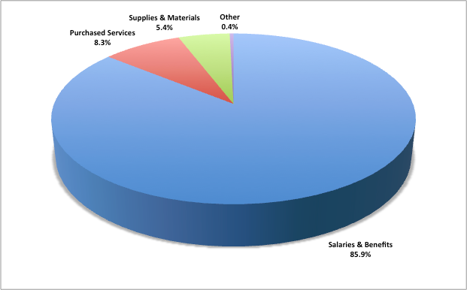
General Fund Expenditures by Object
2013-14
Notes:
To run the “Shoreline Model” of education almost 86% of the whole budget goes to salaries and benefits for all the staffing needs. The combined State and Federal funds received are 67% of the total budget.

Slide 3
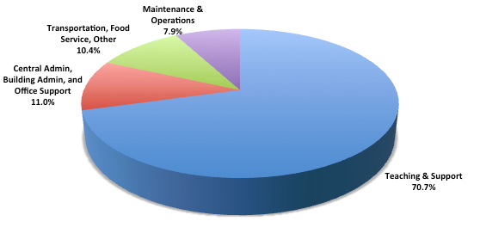
General Fund Expenditures by Activity
2013-14
Notes:
70% of the expenditures go directly to the classroom. Funds are still needed to run the district, provide food services, transportation and carry out the maintenance and operations.

Slide 4
#1. Education Programs, Operations and Maintenance Levy
Basic education programs not covered by state or federal funding:
Nurses, Family Advocates, Librarians and instructional materials
Helps support:
Smaller class sizes
Special Education, Highly Capable, remedial and vocational programs
Building maintenance, utilities
Transportation
Supports extra-curricular student activities:
Music, drama and athletics
From Shoreline School District
10/23/2013 press release

Slide 5
#2. Technology Improvements and Support Capital Levy
Ongoing Technology needs:
Student computers,
Expanded online curriculum for classroom use
Instructional specialists
Equipment upgrades and replacement including lab & library computers, printers, audio visual equipment.
Professional development and training
Server and network replacements and upgrades
Subscriptions and virus/firewall protection
From Shoreline School District
10/23/2013 press release

